Slide 1
Resilience Skills for Work-Life Balance by Amy Tolar
Notes:
MRT Instructions:
(If applicable) Introduce yourself and briefly share your experience as a participant in MRT.
Add your personal motivation step and grab the students attention preparing them for the lesson.
(If applicable) Ask participants to introduce themselves if they do not know each other and if the size of the class permits
Introduce the course as part of Comprehensive Airman Fitness
Distribute participant guides

Slide 2
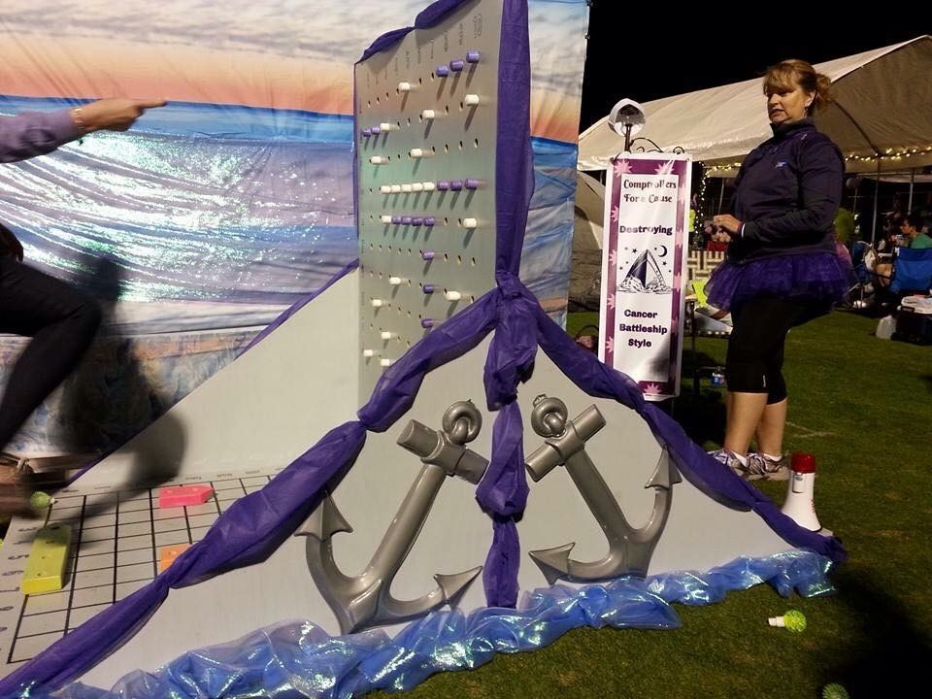
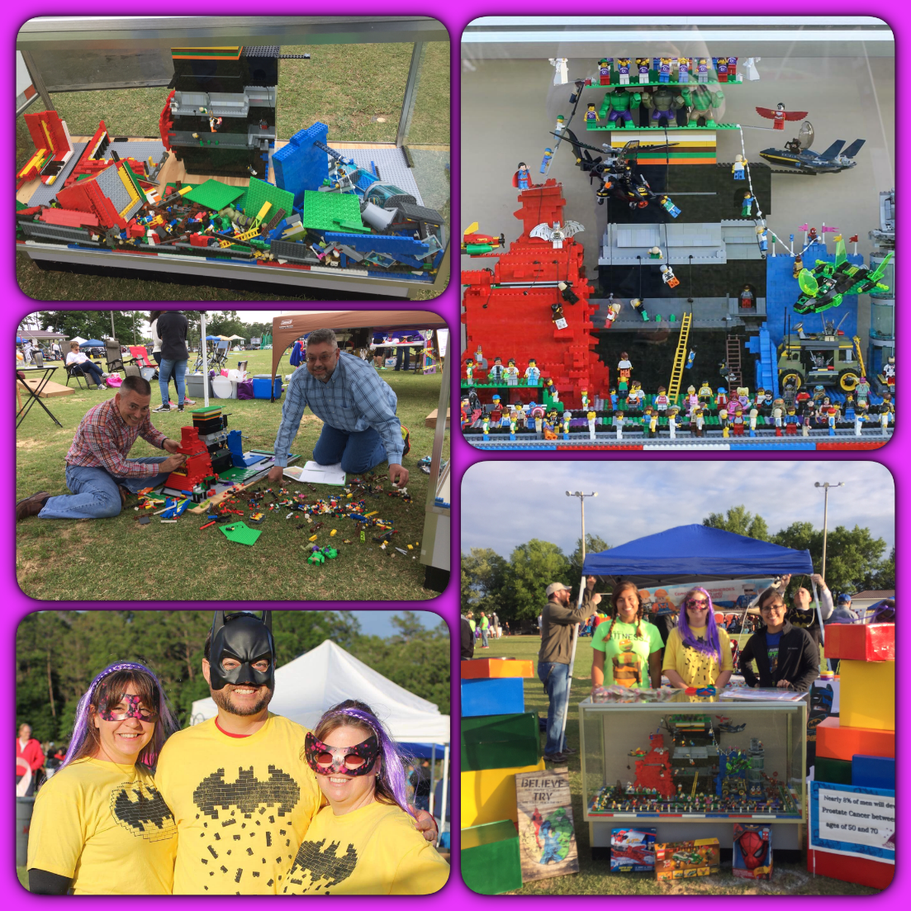
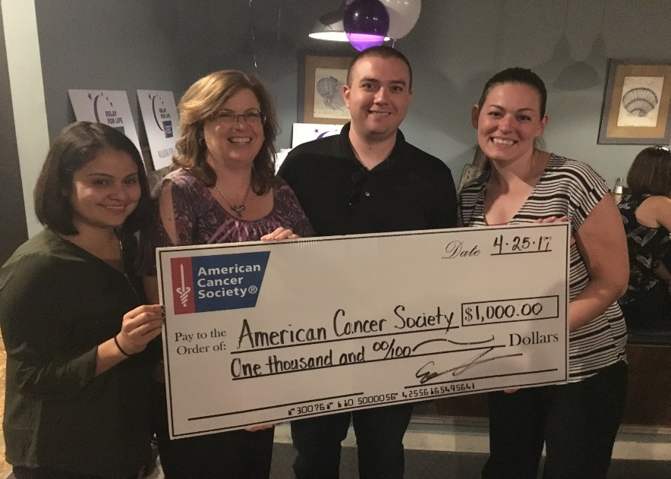
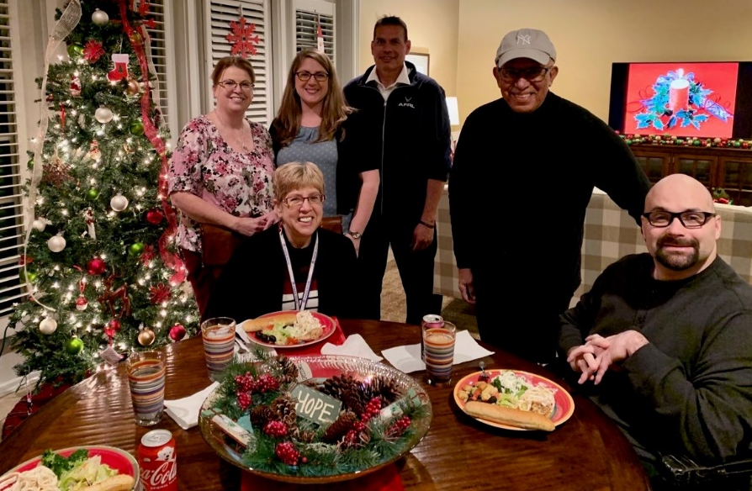
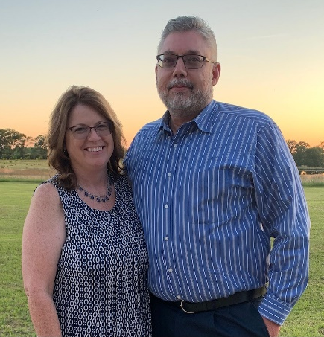
Who Am I
Amy Tolar - Financial Manager
Force Support Squadron (Aviano, Italy) NAF Office
Hurlburt and Eglin Comptroller Squadron’s
Test Wing and Air Force Research Laboratory (AFRL)
Currently in AFLCMC/EBAI FMS
Born and raised in Florida
Married for 20 years
I’ve been an resiliency training for 3 years
Volunteer - Relay for Life, ASMC, & Fisher House

Slide 3
Objectives
Resilience
Work-Life Balance
Reframe

Slide 4
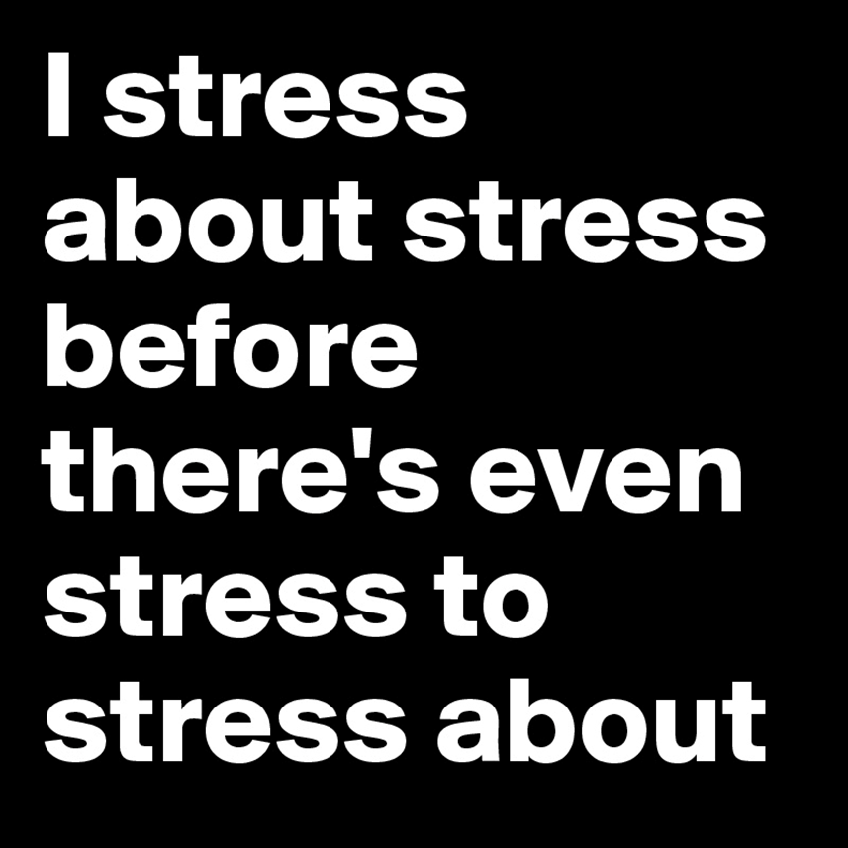
What is resilience?
The ability to withstand, recover and/or grow in the face of stressors and changing demands.
Notes:
MRT Instructions:
1. MP 4: Resilience Defined:
Definition of resilience: The ability to withstand, recover and/or grow in the face of stressors and changing demands.
Resilience enables an individual to over come daily hassles and major obstacles.
Allows you to cope and adapt to adversity or stress to be successful even when under significant stress.
b) Being resilient doesn’t meant you won’t experience adversity. But, if you do, resilience can protect you from the adverse effects of stressful life events.
2. People can learn resilience
Resilience is more than just stories that you hear about when people experience adversity. It can be trained and taught and through practice. Anyone can become a more resilient person.
Research has shown that learning new skills—and practicing those skills—can increase resilience. In particular, focusing on positive coping skills and self-regulation can build our resilience. Training and Practice can actually change our physical Brain Structure. The brain has the ability to rewire to find new ways to do things and adapt - learning new patterns of behaviors and ways of coping can play an important role.

Slide 5
Benefits of resilience
Performance
Health
Creativity, academics, decision making
Teamwork & Leadership
Lower blood pressure, better sleep, longer life span
Valued by team
Notes:
MRT Instructions:
Being a resilient individual can lead to positive outcomes.
Here is what the science of resilience tells us…
Resilient people…
Resilient people have stronger performance and better health. They perform better in a variety of areas to include creativity, academic achievements and decision-making.
Resilient people have lower blood pressure, get better sleep, have healthier immune functioning, and a longer life span
Resilient leaders are more open to feedback from members of their team, more valued by members of the team, and more skilled at reaching consensus during negotiations.

Slide 6
Why Resilience Training?
Allows you to train your mind, just as we train our bodies with physical fitness
Resilience Training provides a set of tools designed to help your personal and professional performance
Notes:
Instructions to Participants:
Why does the Air Force have resilience training? To stay physically fit, we train our bodies with physical training. Your mind is also like a muscle, and the skills you have to help it perform better, the stronger it becomes. Learning and using resilience skills is like training for your mind.
And, just like an effective physical training program that includes different skills to accomplish different goals—cardio, strength training, good nutrition—resilience training includes multiple tools designed to help you be mentally prepared and improve your personal and professional performance.

Slide 7
Famous failures
Notes:
Embed Famous Failures Video
MRT Instructions:
Famous Failures:
Embed or have the capability to show video of famous failures
Have students watch the famous failure video
Note that these are real life instances of resilience
Key Question to ask:
What allowed these individuals to become successful?
Anticipated Responses: Perseverance, strength, Growth Mindset, flexibility, belief in their mission, belief in themselves, not allowing another individual to define them etc…
Resilience is not only about traumatic moments—it is also about dealing with daily hassles and stressors.
It is about ordinary peoples accomplishments in the face of challenges and stressors.
These individuals are now very famous for their accomplishments but they all experienced adversity and grew.

Slide 8
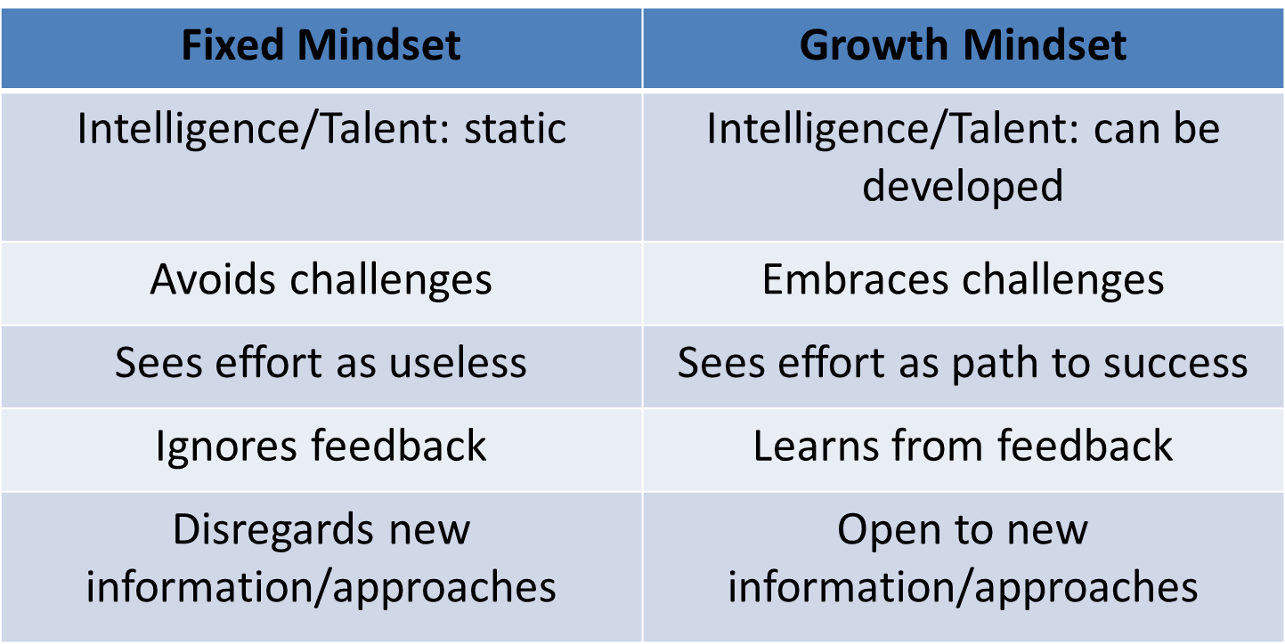
Fixed vs. Growth Mindset
Notes:
MRT Instructions:
Having a growth mindset is critical for learning resilience skills.
Discuss the differences on the slide between a fixed vs growth mindset.
Individuals with a fixed mindset believe their talents and abilities can’t be improved. They avoid challenges because of the risk of failure.
Individuals with a growth mindset are open to new perspectives, and believe that challenges are an opportunity for personal growth.
Think about the mindset you have as you approach learning new skills. Ask your course participants which mindset they bring to training. Remember that growth and fixed mindsets are two ends on a spectrum—it is a continuum and we slide up and down that continuum. In some areas of our lives, we may have a more fixed mindset, and in others we may have a more growth mindset.

Slide 9
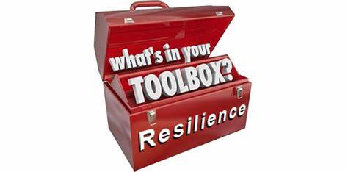
Resilience Toolbox
Being resilient doesn’t meant you won’t experience adversity. If you do, resilience can buffer the adverse effects of stressful life events.
Individuals who use a broader range of coping strategies experience less distress from stressful life events.
Learn tools and skills to strengthen your resilience.
Try them
Use them
Teach them
Notes:
The goal of this course is to provide you with a set of tools. When you leave this class, you can decide which tool you will use and when
MRT Instructions:
Discuss the bullet points on the slide
The goal of RTA training is to ensure you have the tools and resources you need to become a CAF asset and initiate squadron level functions that reinforce the resilience concepts and strategies.
Having flexible coping strategies is linked to lower distress after a stressful life event (Bun Lam and McBride-Chang, 2007). What does that mean for you? Flexibility in the use of coping strategies contributes to resilience, so have a range of tools in your toolbox.
Not every tool is right for every situation, but you need a wide range of tools, and need to know which one is best in a given situation. There may be a tool that doesn’t work for you. If so, learn it and practice it so you can teach it to others.
This curriculum will allow you to train your Airmen and Family members on resilience.

Slide 10
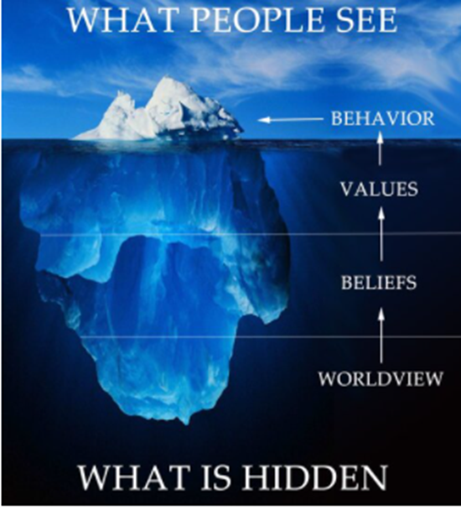
The Iceberg Model
Understand where other’s perspectives are coming from
Put yourself in their shoes
It’s okay to disagree – it’s not okay to disrespect
It’s not a debate – it’s a discussion
How can you agree to disagree
It can be a win - win situation
Notes:
One of my items in my toolbox that I learned is the Iceberg Model.
Self identify your life growing up. (intrinsic) Think about your beliefs and values that are way deep in your inner core.
What do other see? (extrinsic)
Now put your shoes in the person you are having a conversion with that you are disagreeing with. What are their core values? You don’t know! You grew up differently. How can you agree to disagree – in a respectful manner?

Slide 11
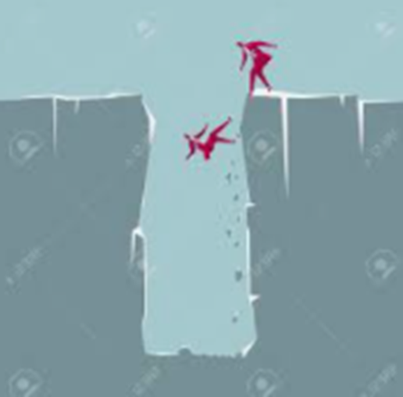
The Pit
Help I’ve fallen and I can’t get out of the pit!
If you are facing a challenge, reach out to someone on your team.
I see you down there!
Let me get a rope to help you get out of that pit!
Let me get others to help me - help you!
Notes:
Other items in toolbox!
How can you help your co-workers to get out of the pit?
There are not only pits out there but there are detours, testing, unexpected things that come up, thing that make us go out of the way – yet like detours, you come back to the place you needed to be.
Is the Pit a detour? Think of a flight you have taken – was it delayed? If so, how did you react? Get mad or was okay with it? Looking back was it a blessing in disguise.
While in the pit, what can’t you have? Food, water (nourishments; company/conversation,
What keeps you going in the pit – encouragement – it gives you hope!
What gets you out of the pit, detour – releases the negative energy? Walking, talking, working out?
If you get angry in the pit, you might have to encourage positive self-talk.
Co-Workers become like Friends & Family!
Long hours at work
Team moral and fun activities
Especially in a crisis

Slide 12
Listening Skills
A
B
C
D
E
Be Responsive
Care About the Other Person
Don’t Interrupt
Encourage the Person to Say More
Attend with Genuine Interest
Notes:
Listen to each other.
Listen with your eyes and ears. Be mindful and be present.
If you are busy (or about to go into a meeting), let that person know you are interested in what they have to say and schedule a time to meet.
When listening validate to the speaker that you are understanding them – How? By repeating what you thought you heard.

Slide 13
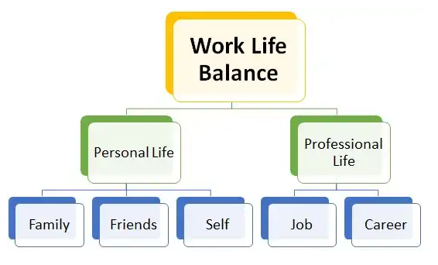
What is Work-Life Balance?
To create a harmonious work-life integration in ones personal and professional life. In a resilience perspective, it is a way to improve our physical, mental, social and spiritual well-being.
Notes:
It is a balance between work and life – right?
Research has shown that learning new skills—and practicing those skills—can increase resilience. In particular, focusing on positive coping skills and self-regulation can build our resilience. Training and Practice can actually change our physical Brain Structure. The brain has the ability to rewire to find new ways to do things and adapt - learning new patterns of behaviors and ways of coping can play an important role.

Slide 14
How to Improve Work-Life Balance
Accept that there is no 'perfect' work-life balance.
Find a job that you love.
Prioritize your health.
Don't be afraid to unplug.
Make time for yourself and your loved ones.
Take a vacation. Take a walk. Talk with a Friend.
Set boundaries and work hours.
Set goals and priorities (and stick to them).
Notes:
A good work-life balance, said Chris Chancey, career expert and CEO of Amplio Recruiting, has numerous positive effects, including less stress, a lower risk of burnout and a greater sense of well-being. This not only benefits employees but employers, too.
We sleep for 8 hours, 2 to get ready for work, breakfast, coffee. Work for 10 hours (commuting time) and that leave us 4 hours to balance.
We get home from work – relax, dinner, and spend time with family and friends.
14

Slide 15
Questions on Work-Life Balance?
Notes:
MRT Instructions:
(If applicable) Introduce yourself and briefly share your experience as a participant in MRT.
Add your personal motivation step and grab the students attention preparing them for the lesson.
(If applicable) Ask participants to introduce themselves if they do not know each other and if the size of the class permits
Introduce the course as part of Comprehensive Airman Fitness
Distribute participant guides

Slide 16
Reframe
Notes:
MRT Instructions:
(If applicable) Introduce yourself and briefly share your experience as a participant in MRT.
Add your personal motivation step and grab the students attention preparing them for the lesson.
(If applicable) Ask participants to introduce themselves if they do not know each other and if the size of the class permits
Introduce the course as part of Comprehensive Airman Fitness
Distribute participant guides

Slide 17
How does Reframe help you?
Be aware that your thoughts about an event drives how you react
Understand the difference between your thoughts, and emotional and physical reactions
Reframe helps you:
Improve your performance
Act based on your values
Strengthen relationships
Notes:
Instructions to Participants:
This skill is an important foundation for the skills we will learn throughout resilience training
The goal of Re-Frame is to help you:
Identify how your thoughts about an event contributes to your reactions—how you think about something drives how you react to it
Understand the difference between your thoughts, emotional reactions, and physical reactions.
Doing these things helps you improve your performance, act based on your values, and strengthen your relationships.
Ultimately, using ReFrame will help you control how you react.

Slide 18
When to use Reframe
Use the skill:
To understand why you reacted in a certain way
When your reaction was not helpful
In the moment, to slow down
Notes:
Instructions to Participants:
Use ReFrame when you need a better understanding of why you reacted to an event a certain way.
Use ReFrame when you don’t think your reactions were helpful in the situation.
Sometimes, quick reactions can interfere with our goals or our relationships with others. There are times when we need to slow the process down and analyze how our brain is driving our reactions. Use it in the moment to slow down.
You can use ReFrame in the moment to make sure your reactions are helping your goals, are in alignment with your values, and improve your performance. By slowing down and thinking about the connections, you can also use ReFrame make sure your reactions don’t interfere with your performance or values.

Slide 19
MYTH: Event → Reaction
Emotional
Reactions
Event
Physical Reactions/ Behavior
Notes:
The Activating Event
The Consequence – emotional reactions or physical behavior.

Slide 20
Event → Reaction

Slide 21
MYTH: Event → Reaction
Emotional
Reactions
Event
Physical Reactions/ Behavior
Notes:
The Activating Event
The Consequence – emotional reactions or physical behavior.
Something is missing – can you tell me what it is?
Show video next?

Slide 22
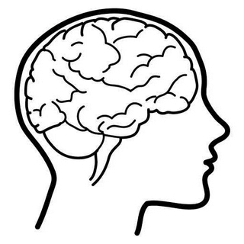
Event → Thought → Reaction
Emotional
Reactions
Event
Physical Reactions/ Behavior
Events aren’t positive or negative…
our interpretations of them are!!
Notes:
This is called the ABC Model
A) Activating Event
B) Brain (belief)
C) Consequence – emotional reactions or physical behavior.
Example Next slide
Other example:
Technology is not on your side…everything seems to not want to work for you.
You have a customer that is just being down right disrespectful and making your job difficult.
My supervisor sent me an email Friday telling me to come see him/her first thing Monday morning.

Slide 23
The ABC Model Activating Event → Brain (Thought) → Reaction/Behavior
Emotional
Reactions
A driver cuts you off on the way to work.
Physical Reactions/ Behavior
Notes:
•Instructions to Participants:
Let’s work through an example of the Event “to” Thought “to” Reaction chain. Let’s start with the event: A driver cuts you off on your way to work.
• Be sure to describe the event in an unbiased way to ensure you don’t flavor the event with your thoughts (for example, in “that jerk cut me off,” you are including the thought that the driver is a jerk).
• Note that there are multiple thoughts someone could have about this event. You could have multiple thoughts (for example, that guy is crazy & I can’t believe he did that). And, different people can have different thoughts or interpretations about the same event (that guy must be drunk, or something must have made him swerve).
Facilitated Discussion: (Ask the questions and allow the participants to identify thoughts and reactions. Make sure participants are correctly categorizing the thoughts, emotional, and physical reactions in their comments).
• Ask: What might you think about the event? How could you interpret what happened?
• Ask: What are your reactions to that thought? (Sample response: If I think the guy is an idiot for not paying attention, I could feel angry.)
• Ask: What might your physical reaction be? (Sample responses: I could start tailgating him or doing something that might be threatening.)
• Ask: Let’s try another thought. If, instead, I think “He may have swerved to miss something in the road, how might that influence your reactions?

Slide 24
Was my reaction harmful?
Did your reactions:
Interfere with your personal life goals or your unit’s mission or objectives?
Undermine your values or what is most important to you?
Hurt your relationships?
In other words, did your reaction help or hurt?
If so, Reframe how you think about the event so you can react in a way that is more helpful
Notes:
Instructions to Participants:
This skill is an important foundation for the skills we will learn throughout resilience training
The goal of Re-Frame is to help you:
Identify how your thoughts about an event contributes to your reactions—how you think about something drives how you react to it
Understand the difference between your thoughts, emotional reactions, and physical reactions.
Doing these things helps you improve your performance, act based on your values, and strengthen your relationships.
Ultimately, using ReFrame will help you control how you react.

Slide 25
Slow down in the moment
Notes:
Video
Link to video:
http://www.youtube.com/watch?v=V9xFgyv8BJI&feature=relmfu

Slide 26
Applying the Reframe skill
Activing event: Deadline for a specific work task
What can you do to help you not be stressed w/this urgent request?
Don’t work more than one task at a time (time management)
Think positive – be positive! I can get this done on time!
Who can help you? Can someone help relieve some of the workload?
Notice your emotional reaction and physical reactions.
If your reaction was harmful, how could you reframe the situation? Can you apologizes for a bad reaction.
Notes:
It’s Monday and I know my boss needs this by Wednesday – what things do I need to do first to complete the task.
1) positive self-talk is important high blood pressure, heartrate.
2) physical behavior – are you acting out? If so, slow down in the moment. Count to ten. It can slow your heart rate down.
2) Go for a walk or walk away from your desk. Yes, sometimes walking away from the problem will help you to comeback refreshed and ready to tackle it quicker.

Slide 27
Activity
Select and event in your life. The event should be recent, memorable and specific. Be objective and focus on one event.
Record your thoughts about the event. What were your “in the moment” thoughts?
List the emotional and physical reactions.
If your reaction was harmful, how could you reframe the situation?
Notes:
Outlook - Refame your mind with positivity. Gratitude builds hope
As discussed with Gratitude - How can positive self-talk and what you see in others affect unit morale?
Outlook refers to our opinions, beliefs, and feelings about different aspects of our lives. It is important to understand that the outlook an employee brings to the organization will directly impact their ability to develop relationships within the organization and ultimately the performance of the team. The greatest thing about outlook is that it is something each individual has the ability to control. The following tips are provided to assist you in cultivating an environment that fosters a positive outlook and builds a culture where team members look forward to coming to work

Slide 28
Use Reframe in the moment to slow down
What are your thoughts that need to be reframed?
Reflect
Notes:
Facilitated Discussion:
What was challenging about thinking of something you are grateful for? Or sharing what you are grateful for?
What did you find helpful?
28

Slide 29
Recap of resiliency skills for work-life balance
GOAL for Reframe
To build, strengthen, and maintain important relationships
When to use them:
Work
Home
How to use them:
Ask questions about the event,
show enthusiasm, and
seek additional details.

Slide 30
Questions on Reframe?

Slide 31
Helping Agencies

Slide 33
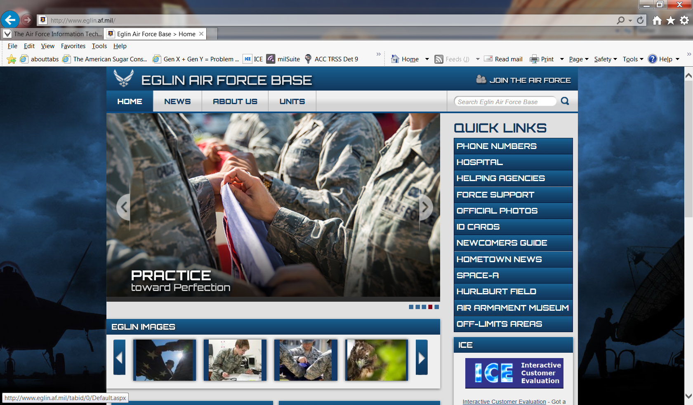

Slide 34
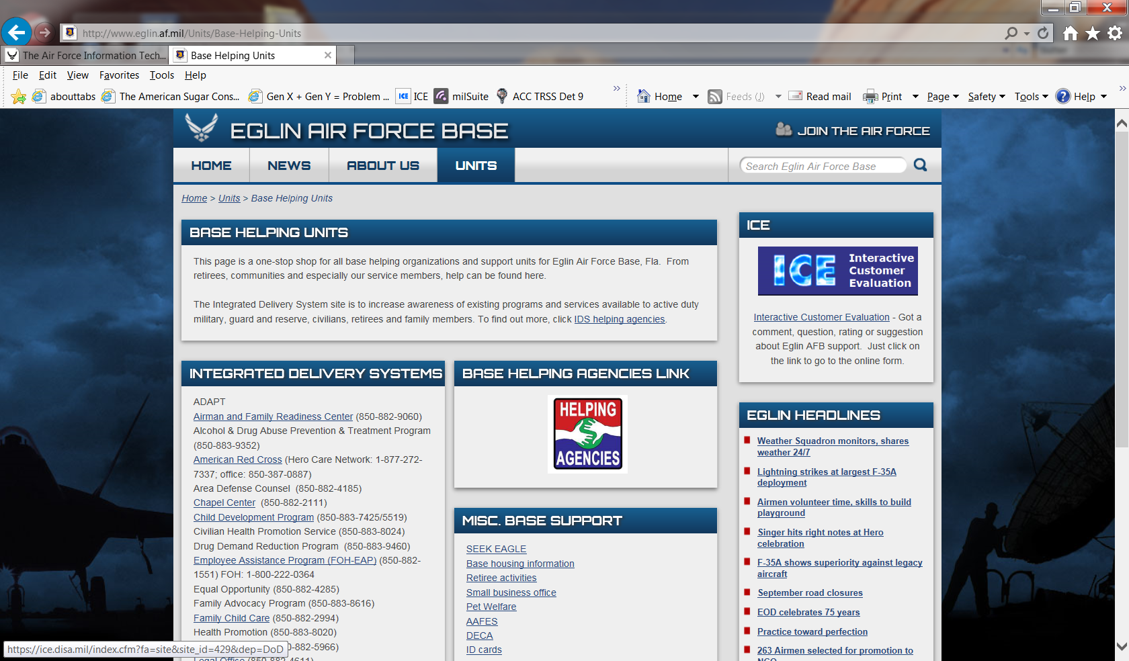

Slide 35
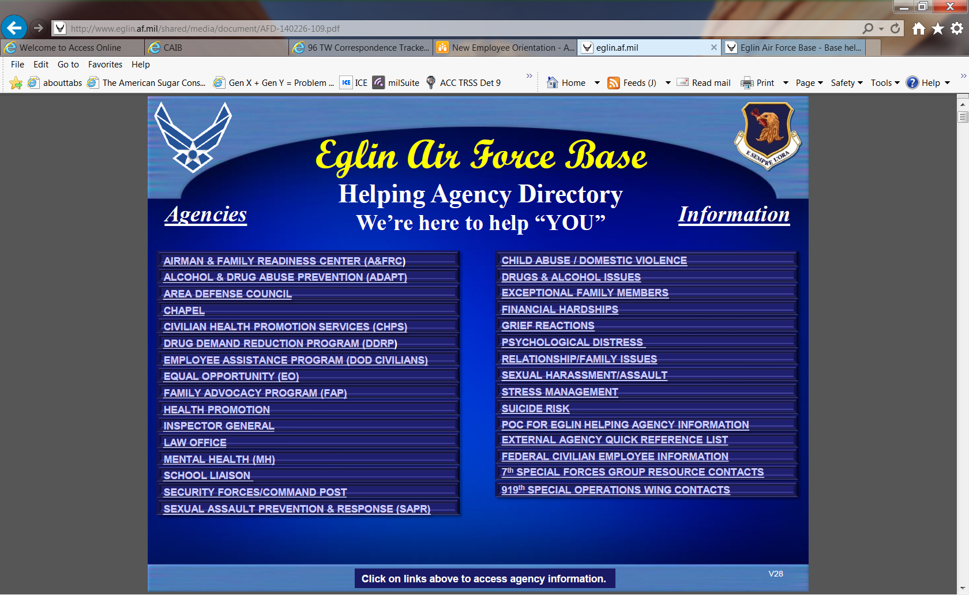

Slide 36
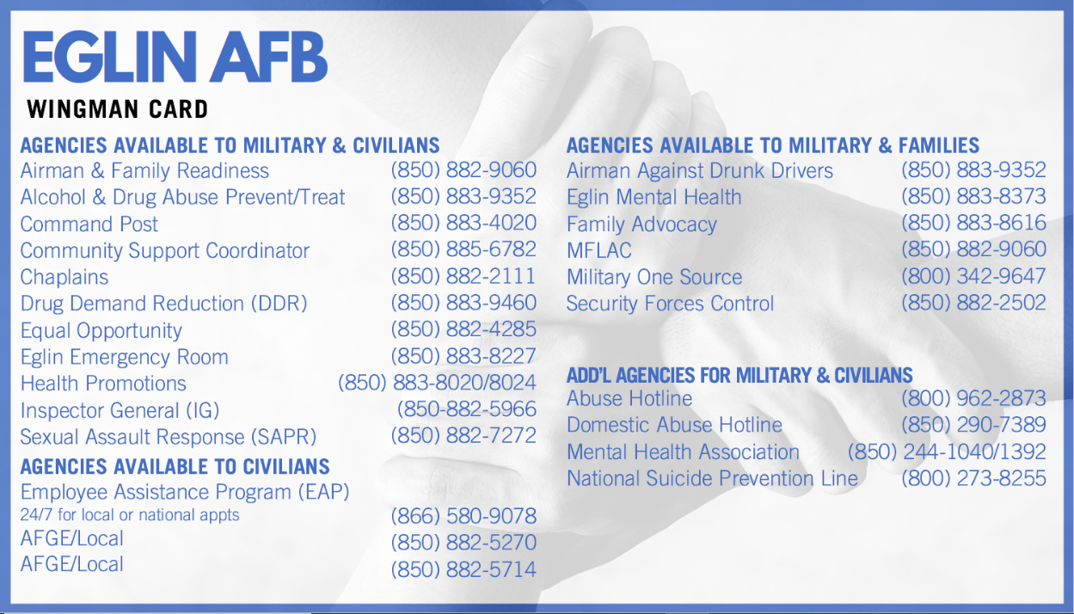

Slide 37
Helping Agencies Facebook Pages
@AirForceEAP
@Eglin-AFB-Health-Promotion
@EglinAFRC
@EglinAirForceBase
@Eglin-Family-Advocacy-Program
@EglinIntegratedResilience
@Eglin-Youth-Center
@TeamEglinChapel
@TeamEglinDisasterMentalHealth

Slide 38
Questions?

